Slide 1


Industrial/Organizational Psychology: An Applied Approach, 9e
Chapter 10: Employee Satisfaction and Commitment
Michael G. Aamodt, Industrial/Organizational Psychology: An Applied Approach, 9th Edition. © 2023 Cengage. All Rights Reserved. May not be scanned, copied or duplicated, or posted to a publicly accessible website, in whole or in part.

Slide 2
Icebreaker
Think about a job or class that you were really dissatisfied with.
What reasons contributed to this lack of satisfaction?
Are there any remediations that your employer or instructor could have made to increase your satisfaction?
Think about a job or class that you were really satisfied with.
What reasons contributed to this satisfaction?

Slide 3
Why Should We Care About Employee Attitudes?

Slide 4
Why Worry About Employee Attitudes?
Outcome | Satisfaction | Commitment
Absenteeism | −0.23 | −0.23
Turnover | −0.22 | −0.23
Lateness | −0.11 | −0.29
Organizational citizenship | 0.24 | 0.25
Counterproductive behavior | −0.37 | −0.36
Performance | 0.30 | 0.17
Commitment | 0.59
Note: Numbers in table are corrected correlations

Slide 5
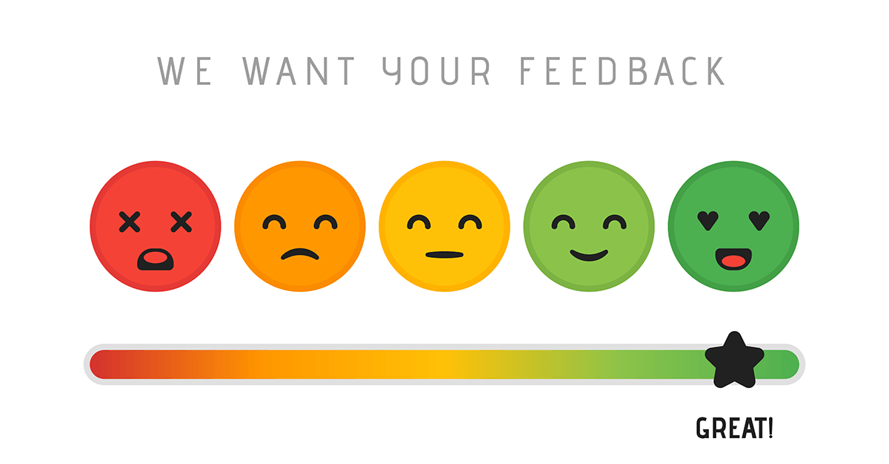
What is satisfaction?

Slide 6
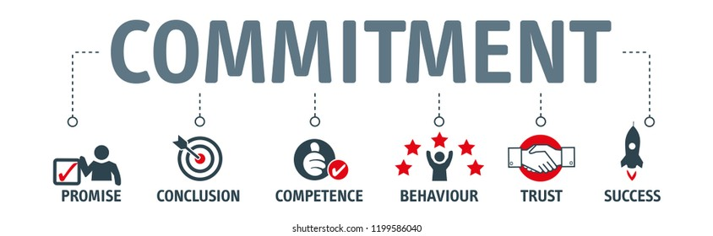
What is commitment?

Slide 7

I/O Psychology in my life
Exercise 10.1: Think of a job in which you were really unhappy. Why was it so bad? Now think of a job in which you were very happy and satisfied. Why was it so good?
What are the consequences of low job satisfaction? What are the benefits of high job satisfaction?

Slide 8
Individual Differences in Employee Satisfaction
Important Findings
Consistency across jobs
Consistency across time
Relationship between life satisfaction and job satisfaction

Slide 9
What Causes Employees to Be Satisfied with and Committed to Their Jobs?

Slide 10
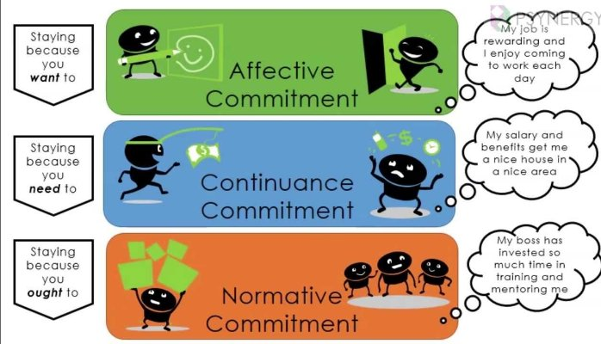
Types of Organizational Commitment
Affective commitment
Continuance commitment
Normative commitment

Slide 11
What Individual Differences Affect Job Satisfaction?
Individual difference theory
Why?
Genetic predispositions
Core self-evaluations
Self-esteem
Self-efficacy
Internal locus of control
Optimism/positive affectivity
Culture
Intelligence

Slide 12
Judge and Bono (2001) Meta-Analysis
Core-Evaluation Trait | Corrected Correlations with: Satisfaction | Corrected Correlations with: Performance
Self-esteem | 0.26 | 0.26
Self-efficacy | 0.45 | 0.23
Internal locus of control | 0.32 | 0.22
Emotional stability | 0.24 | 0.19

Slide 13
Personality Meta-Analysis Results
Personality Trait | Corrected Correlations with: Satisfaction | Corrected Correlations with: Performance | Corrected Correlations with: Turnover
Openness | 0.02 | 0.06 | 0.14
Conscientiousness | 0.26 | 0.24 | -0.16
Extraversion | 0.25 | 0.09 | 0.02
Agreeableness | 0.17 | 0.12 | -0.08
Stability | 0.29 | 0.15 | -0.19

Slide 14
Other Aspects of Employee Lives
Marriage, friends, job, family, geographic location
Hobbies
Volunteer work

Slide 15
International Differences in Percentage of Employees Satisfied with Their Jobs 2019 Randstad Survey
Most Satisfied
89% India
88% Mexico
80% Turkey
79% Norway
78% U.S.
78% Denmark
77% Spain
74% U.K.
74% Canada
74% Brazil
74% China
73% Malaysia
Least Satisfied
42% Japan
49% Hong Kong
61% Singapore
64% Hungary
64% Czech Republic (Czechia)
65% Greece
66% Sweden
68% France
68% Portugal
68% New Zealand
69% Italy
70% Argentina

Slide 16
Workbook Exercises 10.2 Stability of Job Satisfaction

Slide 17
Workbook Exercises 10.3 Core Self-Evaluation

Slide 18
Workbook Exercises 10.4 Your Level of Life Satisfaction

Slide 19
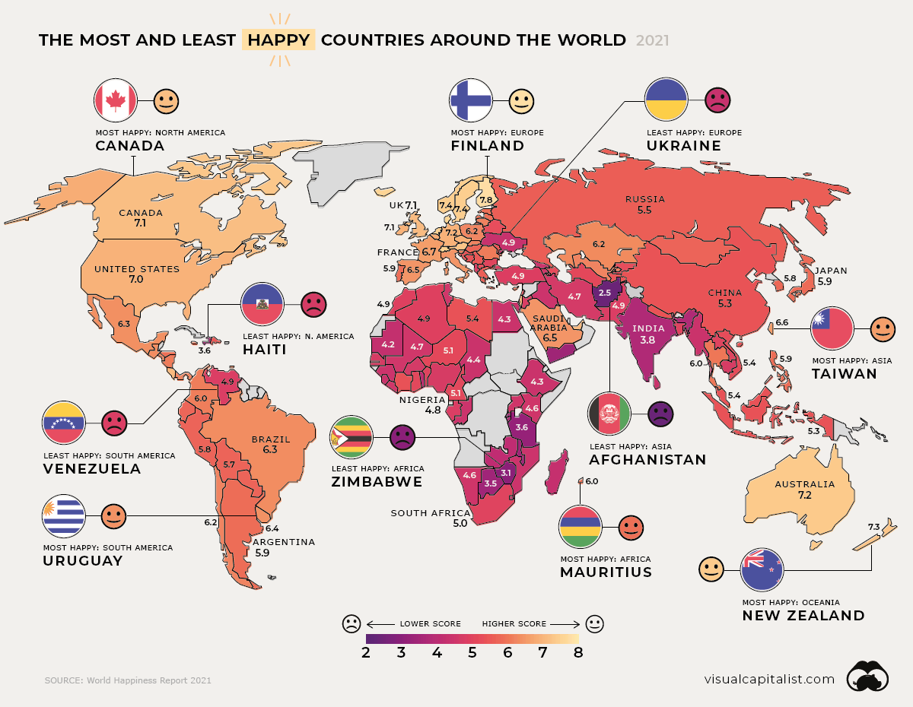

Slide 20
Activity: Discussion
Are you surprised by the differences between satisfaction levels of the countries in the study?
Which country would you have expected to be most satisfied or least satisfied that you did not see in the list?

Slide 21
Discrepancy Theories
Have the employee’s expectations been met?
Realistic job previews (RJPs)
Is the employee a good fit?
Vocation
Job
Organization
Coworkers and supervisor
Have the employee’s needs, values, and wants been met?
Lower job satisfaction
Lower organizational commitment
Greater intentions to leave

Slide 22
Person-Organization Fit Kristof-Brown et al. (2005) Meta-Analysis
Attitude or Behavior | Employee Fit with: Organization | Employee Fit with: Group | Employee Fit with: Supervisor | Employee Fit with: Job
Satisfaction | 0.44 | 0.31 | 0.44 | 0.56
Commitment | 0.51 | 0.19 | 0.09 | 0.47
Performance | 0.07 | 0.19 | 0.18 | 0.20
Turnover | −0.14 |  |  | −0.08
Turnover intent | −0.35 |  |  | −0.46
Absenteeism | −0.05

Slide 23
Job Facets
Are the tasks enjoyable?
Do the employees enjoy working with their supervisors and coworkers?
Are coworkers outwardly unhappy

Slide 24
Are Rewards and Resources Given Equitably?
Equity Theory: my effort = effort of my peers
Components
Inputs
Outputs
Input/output ratio
Possible Situations
Underpayment
Overpayment
Equal payment

Slide 25
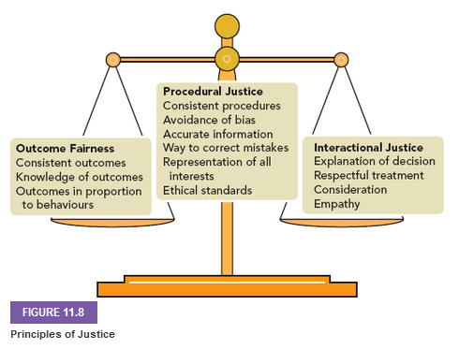
Organizational Justice
Distributive justice
Procedural justice
Interactional justice
Informational justice
Open + transparent
Interpersonal justice
Adequately treats employee

Slide 26
Organizational Justice Meta-Analysis Results
Outcome | Procedural Justice | Distributive Justice
Job satisfaction | 0.62 | 0.56
Organizational commitment | 0.57 | 0.51
Absenteeism | −0.46 | −0.50
Performance – employee level | 0.24 | 0.26
Counterproductive work behaviors | −0.28 | −0.28

Slide 27

Is There a Chance for Growth and Challenge?
Enriched jobs
Variety of skills needed
Employee completes entire task
Tasks have meaning
Employee has input/control
Employee receives feedback
Methods
Job rotation
Job enlargement
Job enrichment

Slide 28
Activity: Discussion of Job Changes
If you have experienced job rotation, job enlargement, or job enrichment on a job before, did you feel more challenged or that you were given an opportunity for growth?
Would you look forward to the implementation of these methods in your future careers?

Slide 29
Measuring Job Satisfaction and Commitment

Slide 30
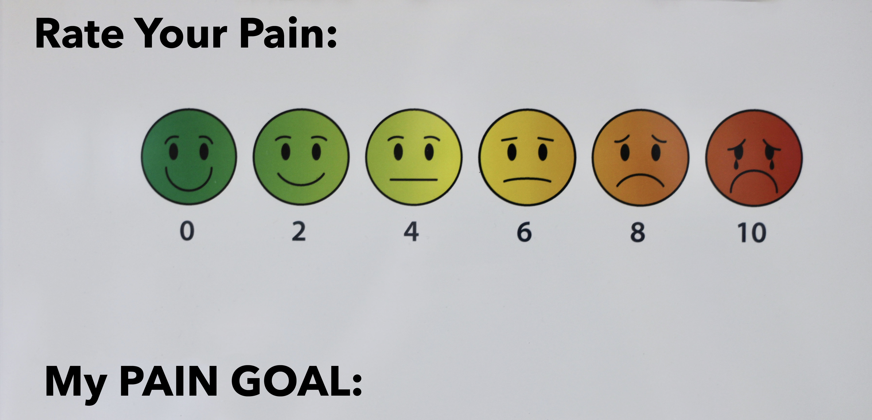
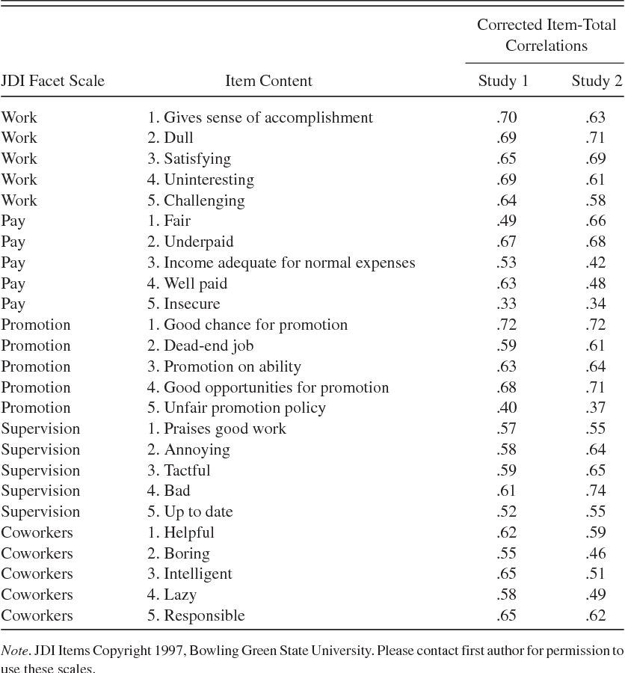
Measuring Job Satisfaction
Faces Scale
Job Descriptive Index (JDI)
Minnesota Satisfaction Questionnaire
Job in General (JIG) Scale
Nagy Job Satisfaction Scale

Slide 31
Measuring Commitment
Allen and Meyer survey
Organizational Commitment Questionnaire
Organizational Commitment Scale
Custom-designed inventories

Slide 32
Workbook Exercise 10.5 Case Study

Slide 33
Consequences of Dissatisfaction and Other Negative Work Attitudes

Slide 34
Absenteeism
U.S. workers missed 3% of work (Bureau of Labor Statistics, 2020)
Holidays, sickness, parental leave
Moderately correlated with turnover

Slide 35
International Differences
Country | Absenteeism Days
Australia | 11.2
Bulgaria | 22.0
Germany | 18.3
Czech Republic (Czechia) | 15.4
Norway | 14.6
Switzerland | 1.6
Ukraine | 4.1
Malta | 4.2
United Kingdom | 4.4
Canada | 11.6

Slide 36
Actual Employee Excuses for Missing Work
I was sprayed by a skunk.
I tripped over my dog and was knocked unconscious.
My bus broke down and was held up by robbers.
I was arrested as a result of mistaken identity.
I forgot to come back to work after lunch.
I couldn’t find my shoes.
I hurt myself bowling.
I was spit on by a venomous snake.
I totaled my wife’s jeep in a collision with a cow.
A hitman was looking for me.
My curlers burned my hair and I had to go to the hairdresser.
I eloped.
My cat unplugged my alarm clock.
I had to be there for my husband’s grand jury trial.
I had to ship my grandmother’s bones overseas. (Note: she had passed away 20 years ago)
Source: 2004 CareerBuilder.com Survey

Slide 37
Increasing Attendance by Having Consequences for Missing Work
Rewards for Attending
Financial incentives
Well pay
Financial bonuses
Games
Paid time-off programs
Recognition programs
Discipline for Not Attending
Clear Policy and Record Keeping

Slide 38
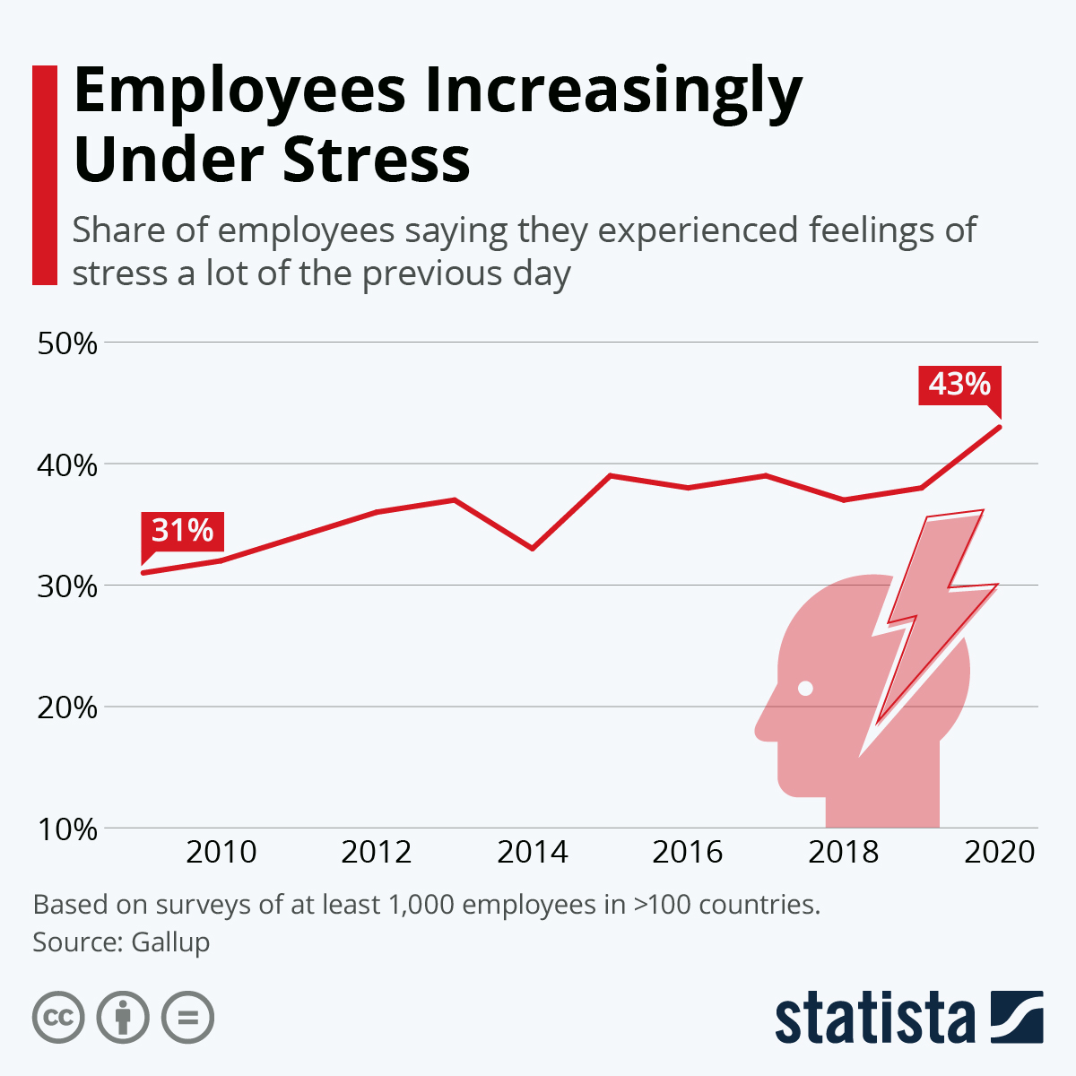
Increasing Attendance by Reducing Employee Stress
Reducing illness
Not hiring “absence-prone” employees
Uncontrollable absenteeism
Bad weather

Slide 39
Workbook Exercise 10.6 Case Study

Slide 40
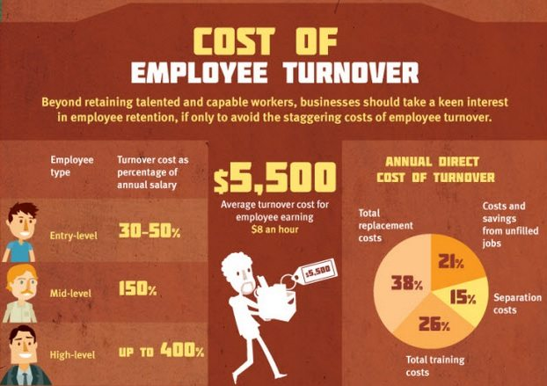
Turnover: Why Do Employees Leave? Unavoidable Reasons and Needs
Unavoidable Reasons
School starts
Job transfer
Illness
Family issues
Advancement
More responsibility
Better pay
Unmet Needs

Slide 41
Turnover: Why Do Employees Leave? Escape or Unmet Expectations
Escape From
People
Management
Coworkers
Customers
Working conditions
Stress
Unmet Expectations
Organization
Job
Career

Slide 42
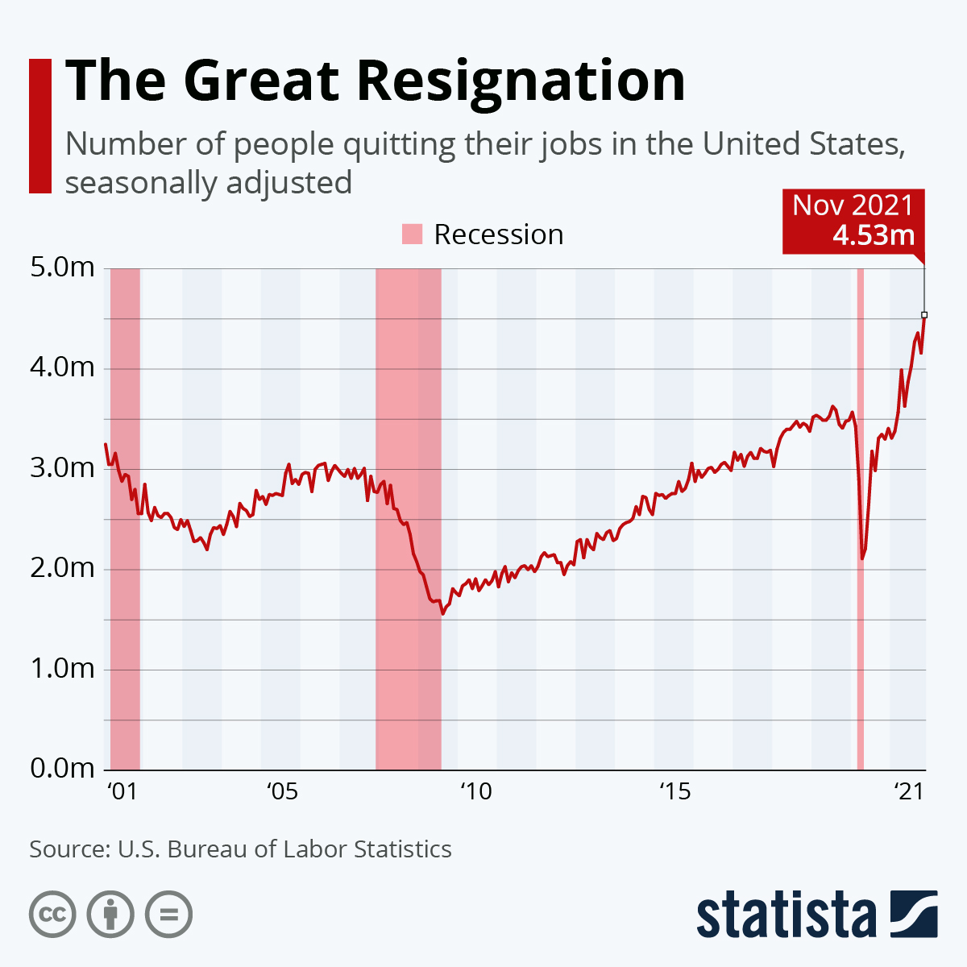
Activity: Discussion of Leaving a Job
Have you left a job because of any of the previous reasons mentioned?

Slide 43
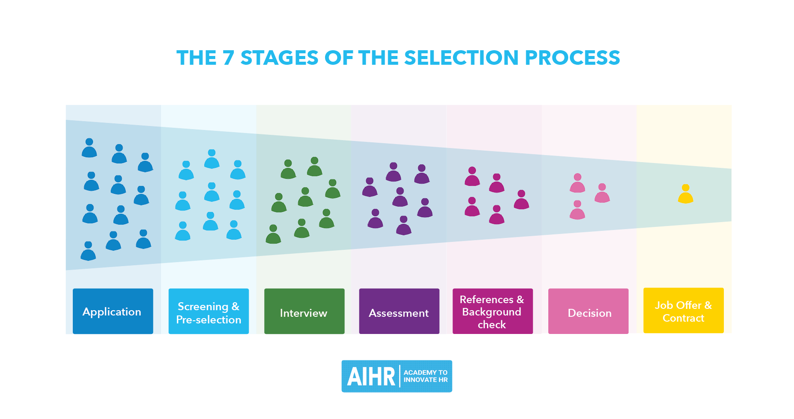
Reducing Turnover Selection Issues
Conduct realistic job previews
Look for person-organization fit
Study predictors of people who leave

Slide 44
Reducing Turnover Compensation Issues
Match the market
Use job evaluation to ensure internal equity
Offer retention/tenure bonuses (stay for pay)

Slide 45
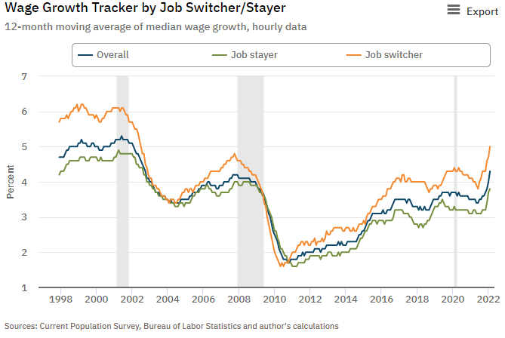
Increasing Salary and Benefits Will Only Work If:
Employees are leaving due to low compensation or benefits
The turnover rate is high
The salary increase will be a meaningful amount

Slide 46
Counterproductive Behaviors
Individuals
Gossip
Negative politics
Harassment
Workplace violence
Bullying
Organization
Theft
Sabotage
Personality Types

Slide 47
Organizational Citizenship Behaviors
“Little things” not required of an employee
Staying late to finish a project
Mentoring an employee
Volunteering for committees
Negative correlation between OCBs and employee counterproductive behavior

Slide 48
Putting It All Together
Applied Case Study: Reducing Turnover at Bubba Gump Shrimp

Slide 49
Activity: Discussion of Ethics
Focus on Ethics: Organizational Commitment

Slide 50
Activity: Discussion of Incentives
Do you think that incentives are a form of bribery? If so, do you think it’s unethical for companies to do this?
What would keep you at a company for a longer period? Would incentives such as an Attendance Reward Program or end of the year bonuses make a difference in whether you left a job?
Do you think that using such incentives is a way for leaders to ignore what they should be doing to make things better for the employees?
What are some other ethical dilemmas that might occur by offering incentives to increase commitment or job satisfaction?

Slide 51
Activity: Self-Assessment
Are some employees “destined” to always be dissatisfied with their job? Why or why not?
What do most employees value and need in a job?
Is it possible to treat all employees equitably? Why or why not?
What is the best way to improve employee attendance?
Which measure of job satisfaction is best? Why?

Slide 52
Activity: Discussion Turnover
What would keep you at a company for a longer period?
Would incentives such as stock options or end of the year bonuses make a difference in whether you left a job?
What do you think is the main reason an employee leaves his/her company?

Slide 53
Summary
Now that the lesson has ended, you should have learned how to:
Explain the importance of job satisfaction and organizational commitment
Identify the individual differences in the predisposition to be satisfied
Increase employee satisfaction and commitment
Measure an employee’s job satisfaction level
Reduce employee absenteeism
Understand why employees quit their jobs and what can be done to reduce turnover
Notes:
Review objectives.

